Slide 1
Improve Customer Experience with Top Tasks Part 3
February 13, 2018
Gerry McGovern
customercarewords.com

Slide 2
CUSTOMER
ARCHITECTURE

Slide 3
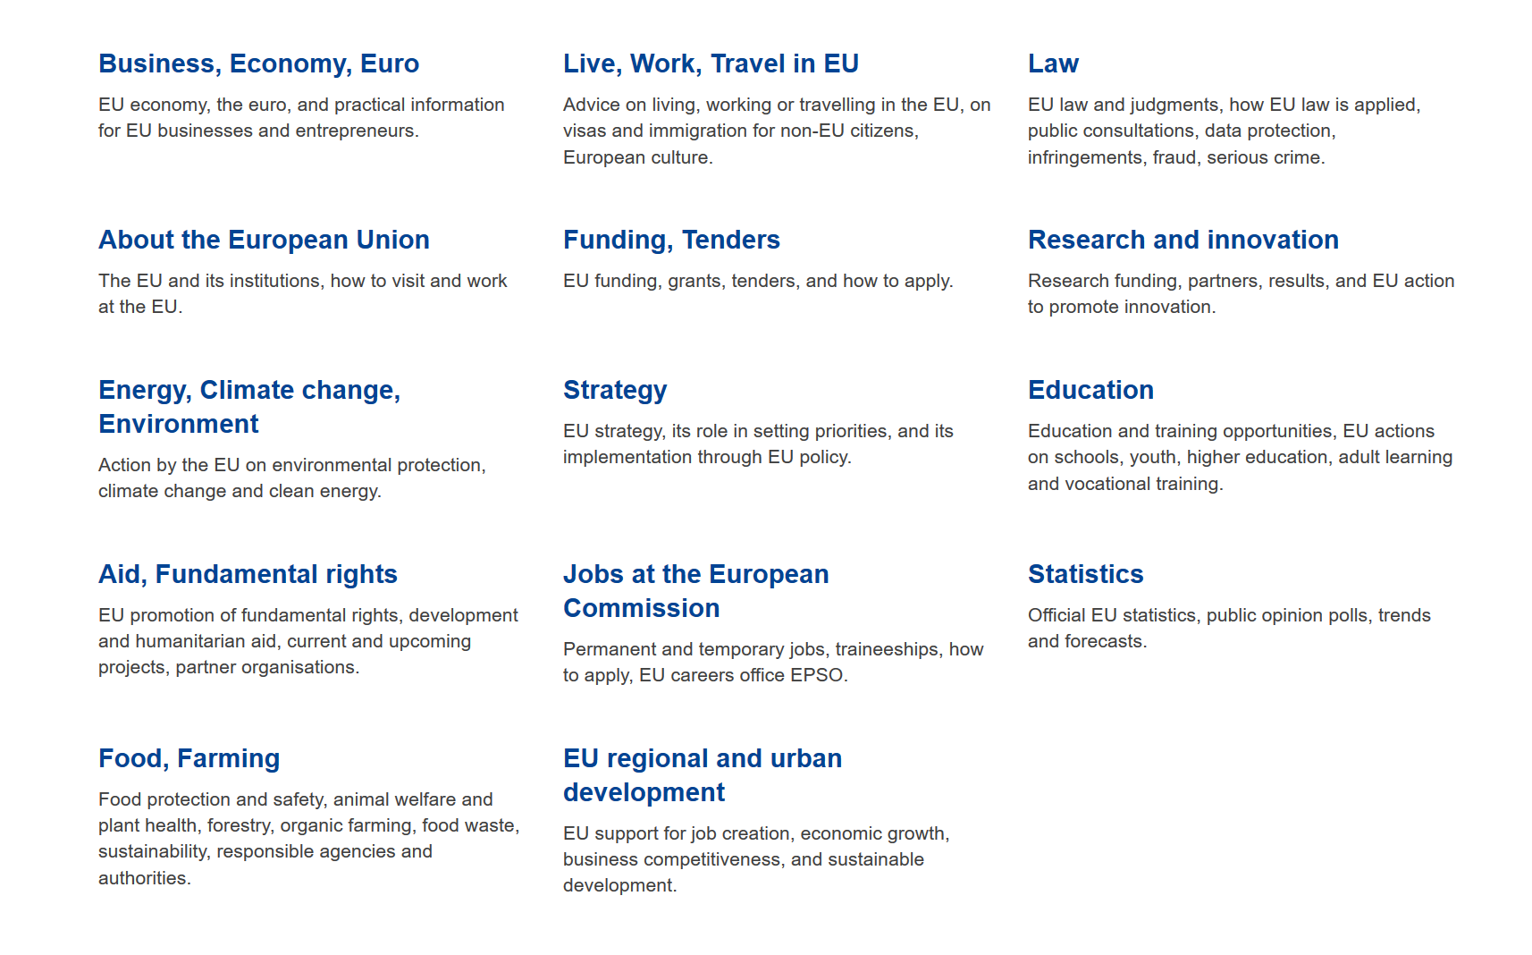

Slide 4
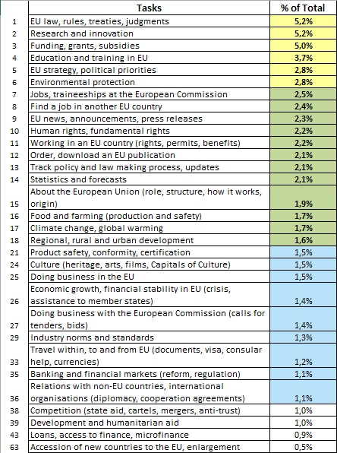
30 classes for sorting
Source: Top task identification project, European Commission

Slide 5
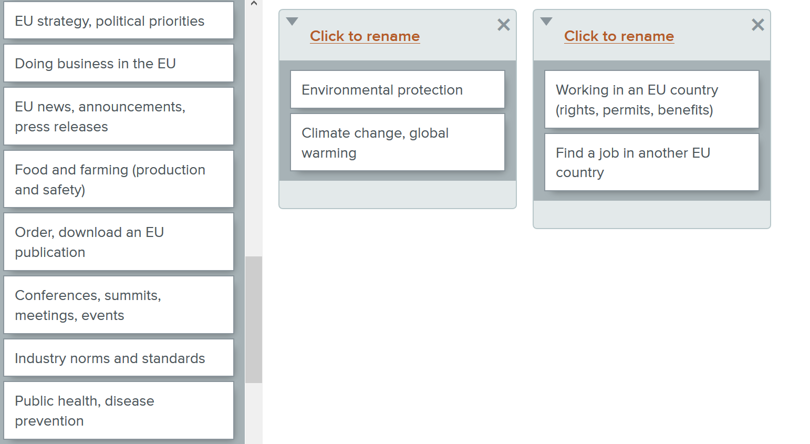
Card sorting methodology
Source: Top task identification project, European Commission

Slide 6
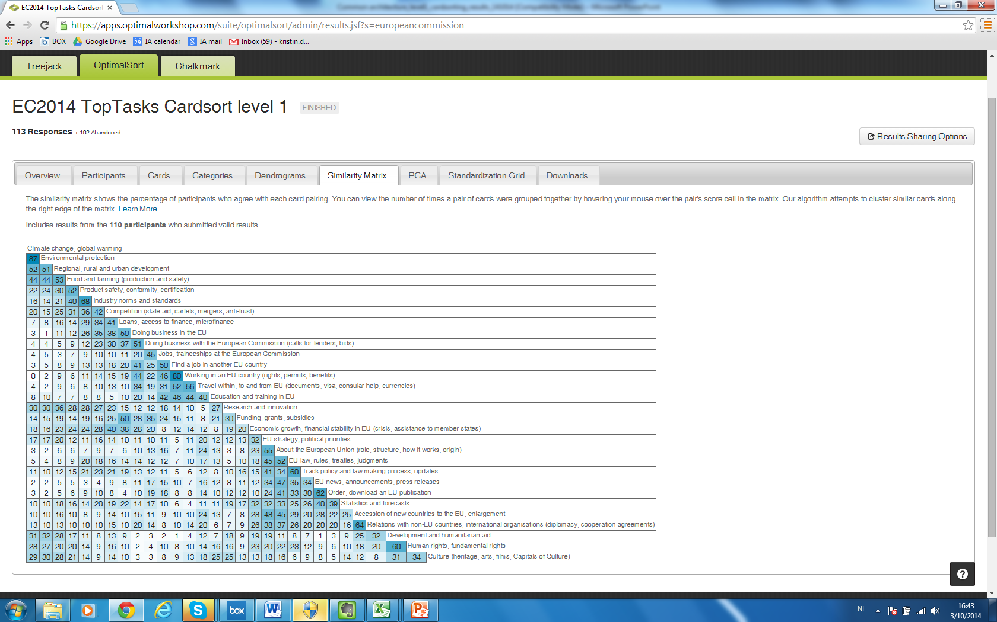
Source: Top task identification project, European Commission

Slide 7
Today’s hypothesis
Source: Top task identification project, European Commission

Slide 8
Funding, grants, subsidies
Top task 3
Instruction:
A researcher wants to start a new project. Find out if there is an EU grant available.
Source: Top task identification project, European Commission

Slide 9
Funding, grants, subsidies
Top task 3
A researcher wants to start a new project. Find out if there is an EU grant available.
Round 1
Round 1
Source: Top task identification project, European Commission

Slide 10

OBJECT
SUBJECT

Slide 11
Funding, grants, subsidies
Top task 3
Instruction:
A researcher wants to start a new project. Find out if there is an EU grant available.
Source: Top task identification project, European Commission

Slide 12
Funding, grants, subsidies
Top task 3
A researcher wants to start a new project. Find out if there is an EU grant available.
Round 2
Round 2
Source: Top task identification project, European Commission

Slide 13
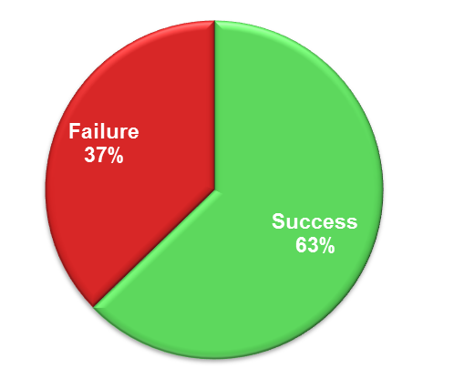
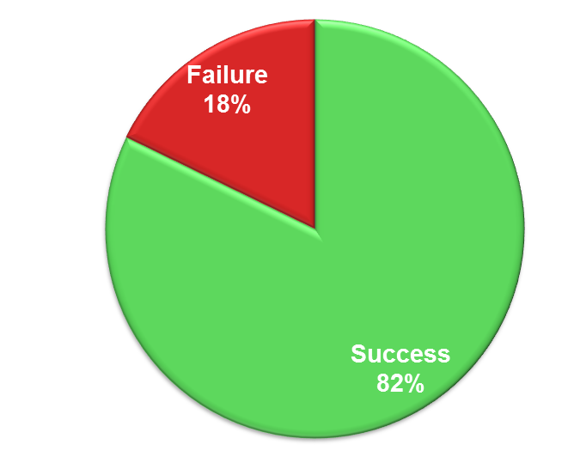
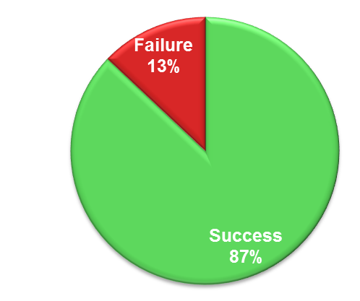
Test results: Overall result
1st test round
2nd test round
3rd test round
Source: Top task identification project, European Commission

Slide 15
TASK
PERFORMANCE
INDICATOR

Slide 16
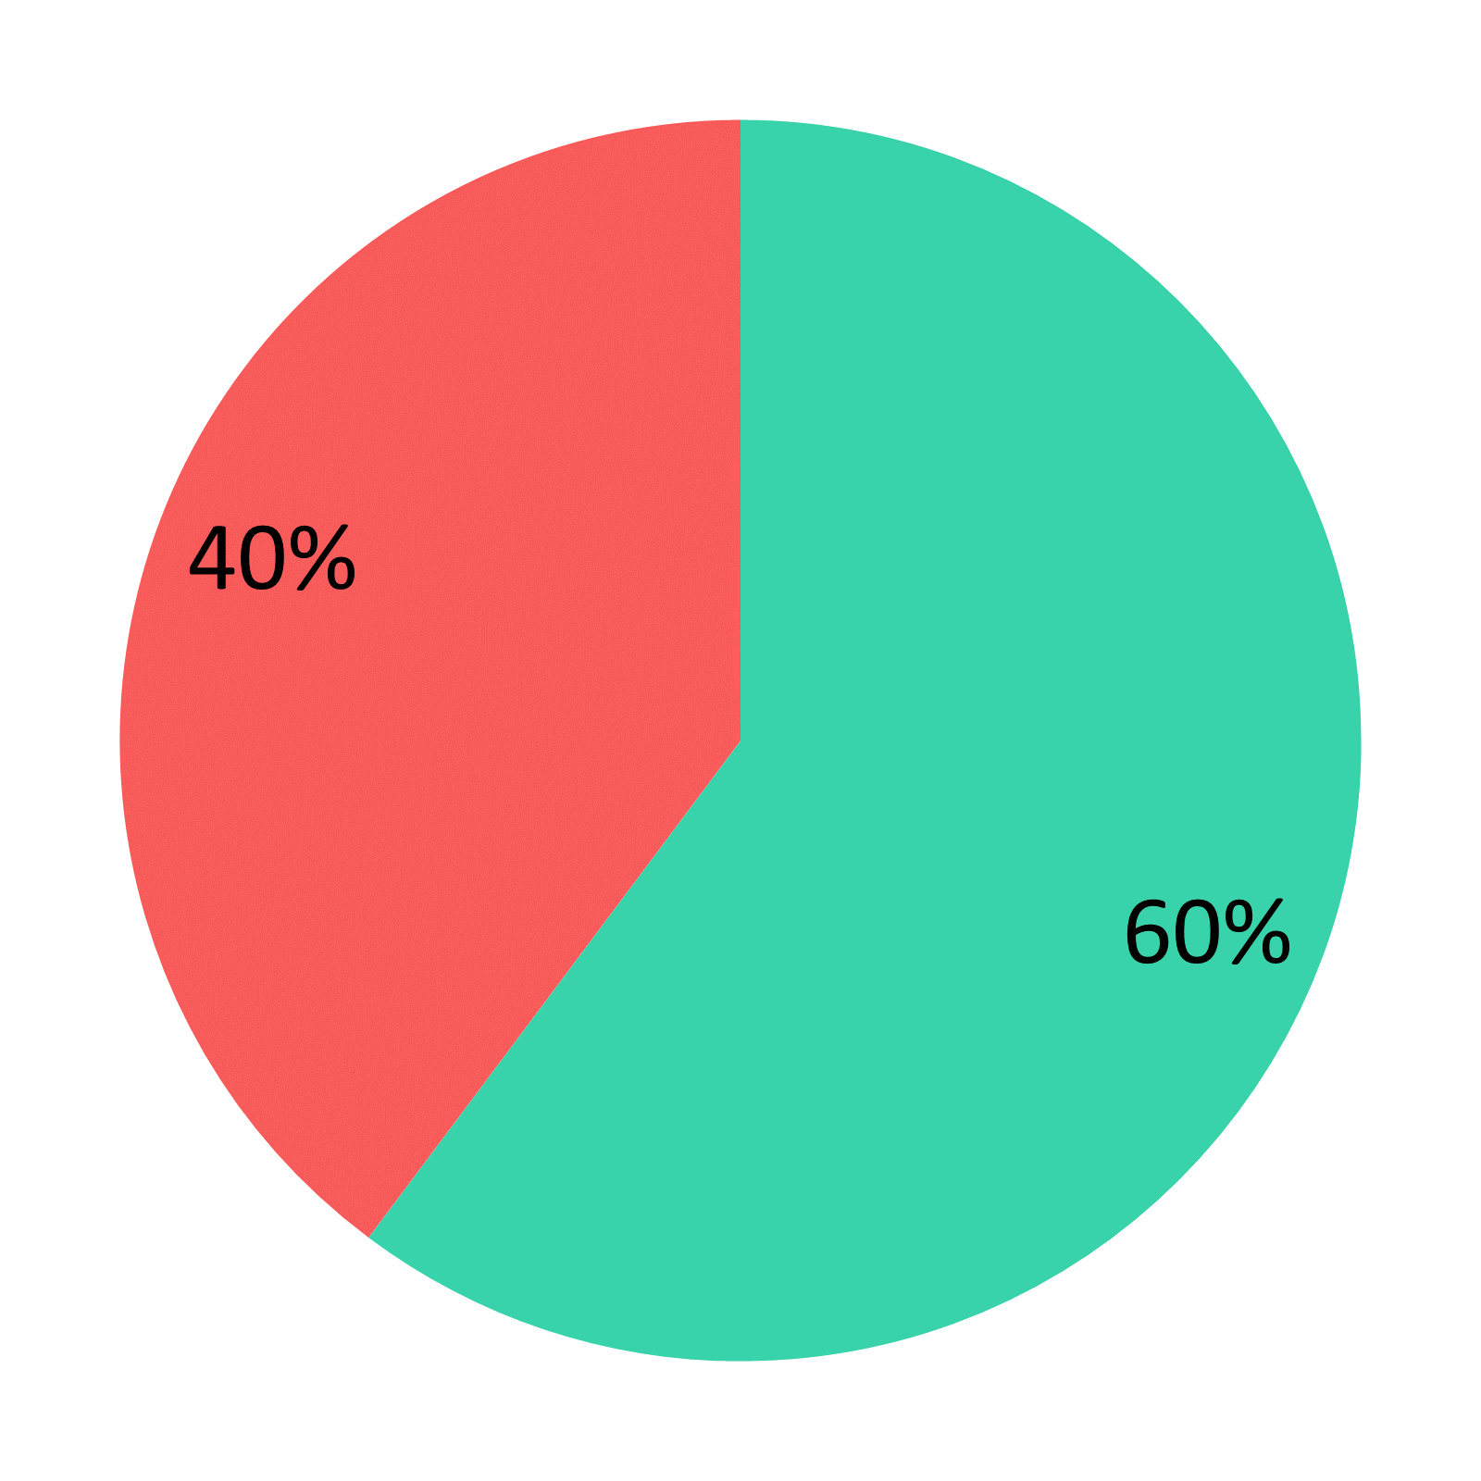
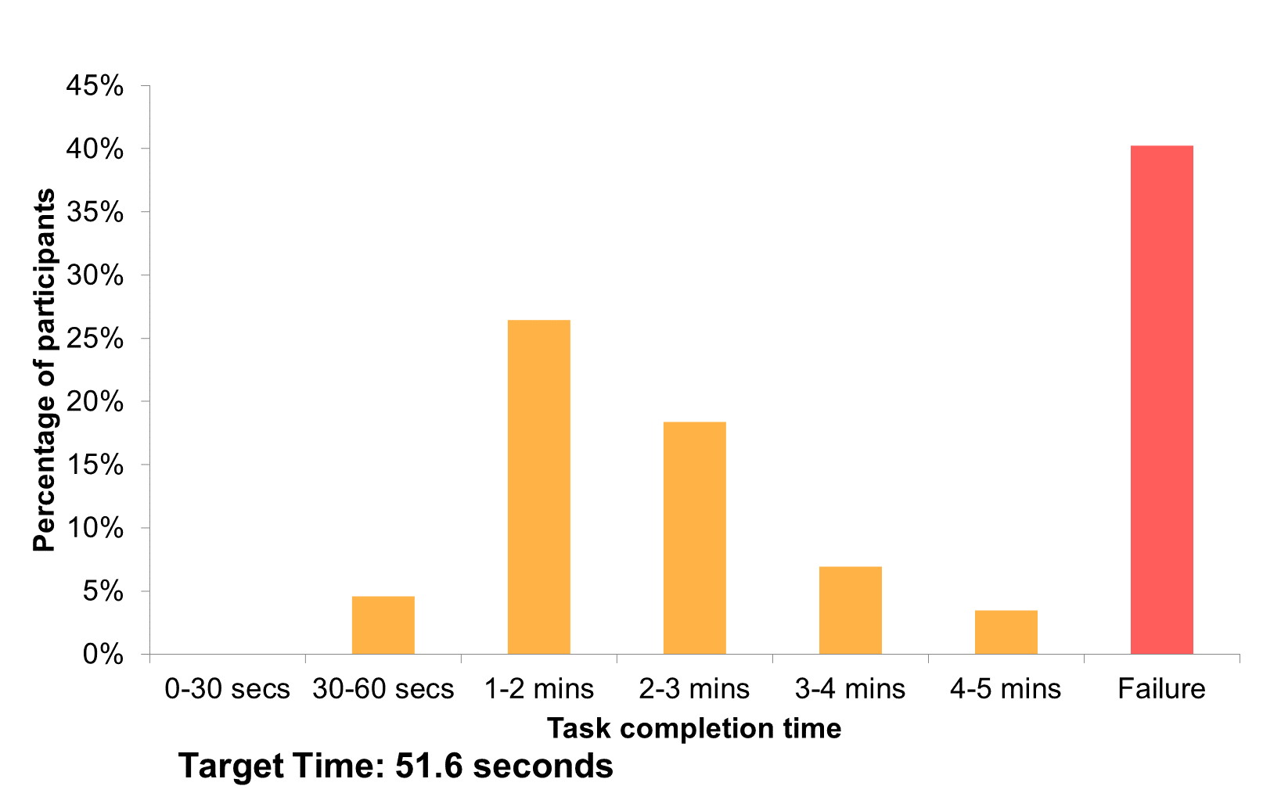
Overall results: Success, Failure, Time

Slide 17
8-12 Top Tasks

Slide 18
UK National Health Service Citizen Top Tasks
SYMPTOMS

Slide 19
Norwegian Hospitals: Top 20 tasks
TREATMENT

Slide 20
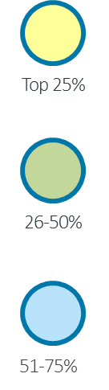
Please look at the following list and choose the top 5 reasons you come to the OECD.
 | Tasks | Total Vote | % of Total Vote 31800 | Cumulative Vote | Cumulative Tasks
1 | Country surveys / reviews / reports | 2178 | 6.8% | 6.8% | 1.4%
2 | Compare country statistical data | 1960 | 6.2% | 13.0% | 2.9%
3 | Statistics on one particular topic | 1869 | 5.9% | 18.9% | 4.3%
4 | Browse a publication online for free | 1610 | 5.1% | 24.0% | 5.7%
5 | Working papers | 1530 | 4.8% | 28.8% | 7.1%
6 | Publication by topic | 1478 | 4.6% | 33.4% | 8.6%
7 | Basic facts, summaries and overviews | 1379 | 4.3% | 37.7% | 10.0%
8 | Statistics on one particular country | 1285 | 4.0% | 41.8% | 11.4%
9 | Statistical forecasts / projections | 1210 | 3.8% | 45.6% | 12.9%
10 | Access to raw data | 1051 | 3.3% | 48.9% | 14.3%
11 | International guidelines and standards (corporate governance, tax havens, etc.) | 1025 | 3.2% | 52.1% | 15.7%
12 | Statistical sources and methods | 1019 | 3.2% | 55.3% | 17.1%
13 | What's new (hot topics, recent publications, events) | 1004 | 3.2% | 58.5% | 18.6%
14 | OECD policy advice by topic, country | 843 | 2.7% | 61.1% | 20.0%
15 | OECD Annual Report | 784 | 2.5% | 63.6% | 21.4%
16 | Publication by country | 746 | 2.3% | 65.9% | 22.9%
17 | Best practice in policy implementation | 739 | 2.3% | 68.3% | 24.3%
18 | Publication by title | 614 | 1.9% | 70.2% | 25.7%
19 | Simple, easy-to-understand tables and graphs | 613 | 1.9% | 72.1% | 27.1%
20 | News releases | 542 | 1.7% | 73.8% | 28.6%
Source: OECD top task identification project

Slide 21
Choosing what tasks to measure
OECD Top Tasks | Qs
Country surveys / reviews / reports | 2
Compare country statistical data | 2
Statistics on one particular topic | 1
Browse a publication online for free | 1
Working papers | 1
Publication by topic | 1
Basic facts, summaries and overviews | 1
Statistics on one particular country | 1
Statistical forecasts / projections | 1
Access to raw data | 1
Total Task instructions | 12
Source: OECD top task identification project
3

Slide 22
5-8 Customers (to identify underlying problems)

Slide 23
13-18 Customers (for statistically reliable data)

Slide 24
These data are from 16 different studies with different tasks and varying between 15 and 31 participants

Slide 25
Task Instructions

Slide 26
Creating task instructions – Representative, typical, fixable
Select task instructions that are typical of the top task in question.
Do not try and choose difficult, unusual, once-off-type tasks.
Cisco top task: Downloading software.
Task instruction: Download the latest firmware for the RV042 router.
This is a popular router
Download process is reflective of many other routers that Cisco sells.

Slide 27
Creating task instructions – Repeatable
Very important: Top Tasks is dependent on testing the same task instructions over time
2009 OECD task instruction: In 2008, was Vietnam in the list of countries that received official development assistance?
2013 OECD task instruction: In 2012, was Vietnam in the list of countries that received official development assistance?
Ongoing Cisco task instruction: Download the latest firmware for the RV042 router.

Slide 28

Creating task instructions – No hidden clues
Do not have any clues within the task instruction
Opposite of Search Engine Optimization
Copy and paste pieces of instruction into search engine
Hide the true intent of the task, where possible
NO: Find the maternity leave policy
YES: Your colleague is pregnant. How many months can she take off?
3

Slide 29

Creating task instructions – 30 words or less
Pasting into chat – short-term memory
Shorter the better
Aim for 20 words or less
Maximum of 30 words
3

Slide 30
Customer Journeys

Slide 31
Customer journeys for task instructions
Top Task 3 for NetApp: Data protection
Task Instruction: Find a document that gives you the ten key benefits of NetApp SnapVault.
Expected Customer Journey:
NetApp.com homepage
Click on ‘Products’ in the Products Mega Menu
Click on ‘Data Protection Software’
On the ‘NetApp Data Protection Software’ page, click on ‘SnapVault’
On the ‘SnapVault’ product page, go to ‘More info’ on the right-hand side, then click on ‘SnapVault Top Reasons PDF’
Landing page: http://www.netapp.com/us/system/pdf-reader.aspx?cc=us&m=ds-5944.pdf&pdfUri=tcm:10-120975
Answer: ‘Top Reasons – Why Use NetApp Snap Vault Replication-Based Disk-to-Disk Backup’ PDF

Slide 32

Creating task instructions Target time

Slide 33
REMOTE OBSERVATION

Slide 34
FASTER

Slide 35
CHEAPER

Slide 36
BETTER

Slide 37

Skills required to measure
Empathetic
Humble
Analytical
Methodical
Patient
Quiet

Slide 38
Skills required to measure – What NOT to do
No Talk Aloud
No exception spotting
No guidance, no hints
No ongoing conversation
No moods
No judgment
No answers
No loud typing
No loud breathing
3

Slide 39
Overall results: Success, Failure, Time

Slide 40
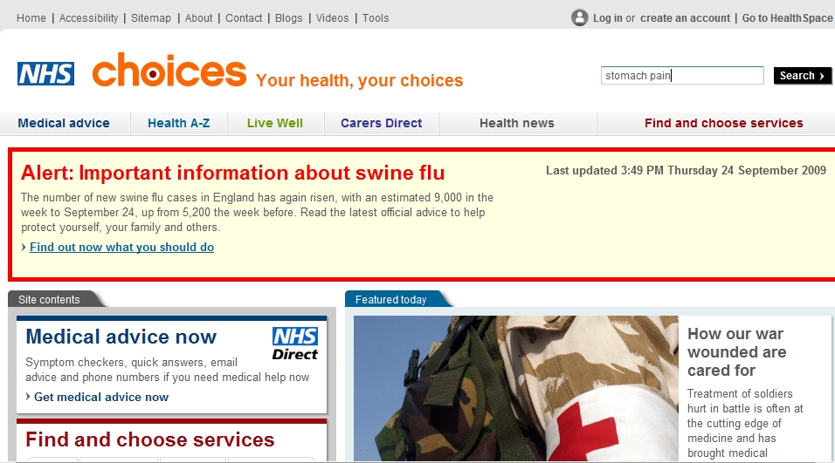

Slide 41
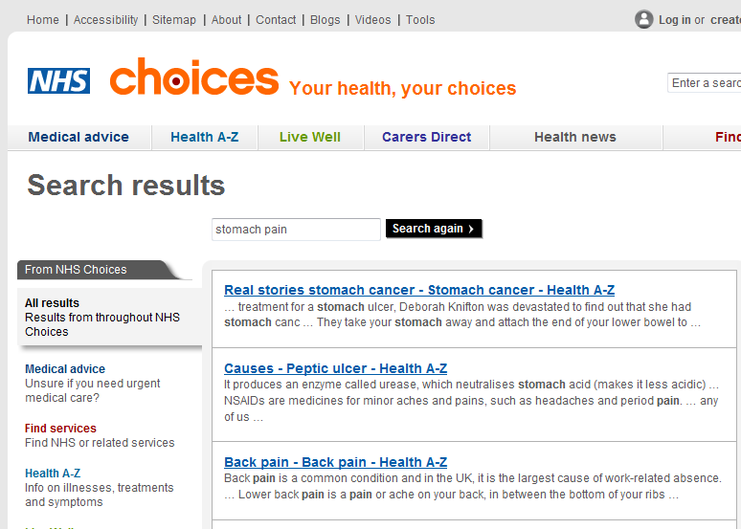
During treatment for a stomach ulcer, Deborah Knifton was devastated to find out that she had stomach cancer. At the age of 40, she had surgery to remove her stomach.

Slide 42
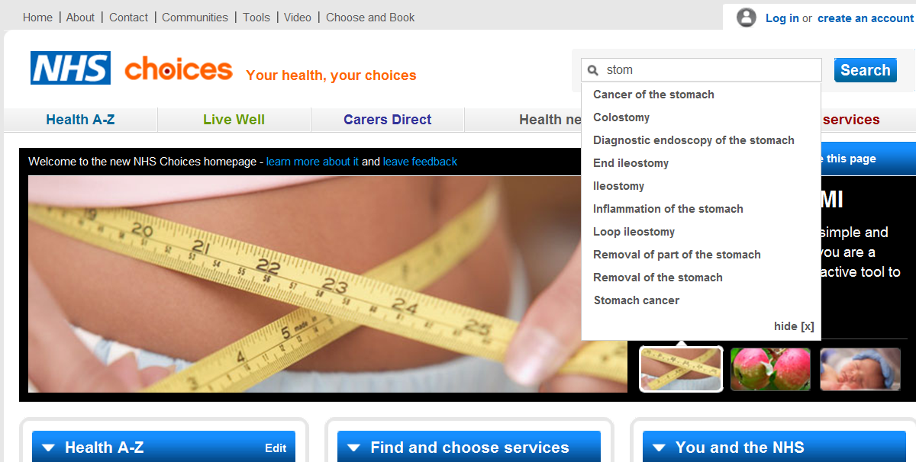

Slide 43
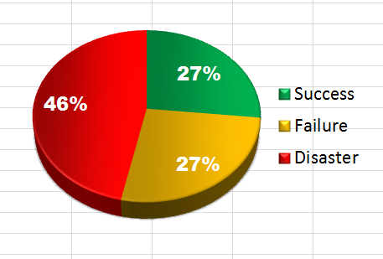
You have a debt owed to you of £2000 for an invoice issued earlier this year. It became overdue on the 1st of July 2011. You have no contract with the debtor. You can charge interest. How much?
Source: task performance indicator project, Business Link UK
Median time on task (sec) =
320.5
Target time on task (sec) =
150

Slide 44
1 Debt
You have a debt owed to you of £2000. It became overdue on the 1st of June 2011. You have no contract with the debtor. You can charge interest. How much?
Navigation path:
http://www.businesslink.gov.uk/
Finance and grants
Debt recovery
Calculate the interest due on an unpaid debt
Go straight to the first question.
Statutory interest
When was the contract formed? (Any date)
When did the payment first become overdue?

Slide 45
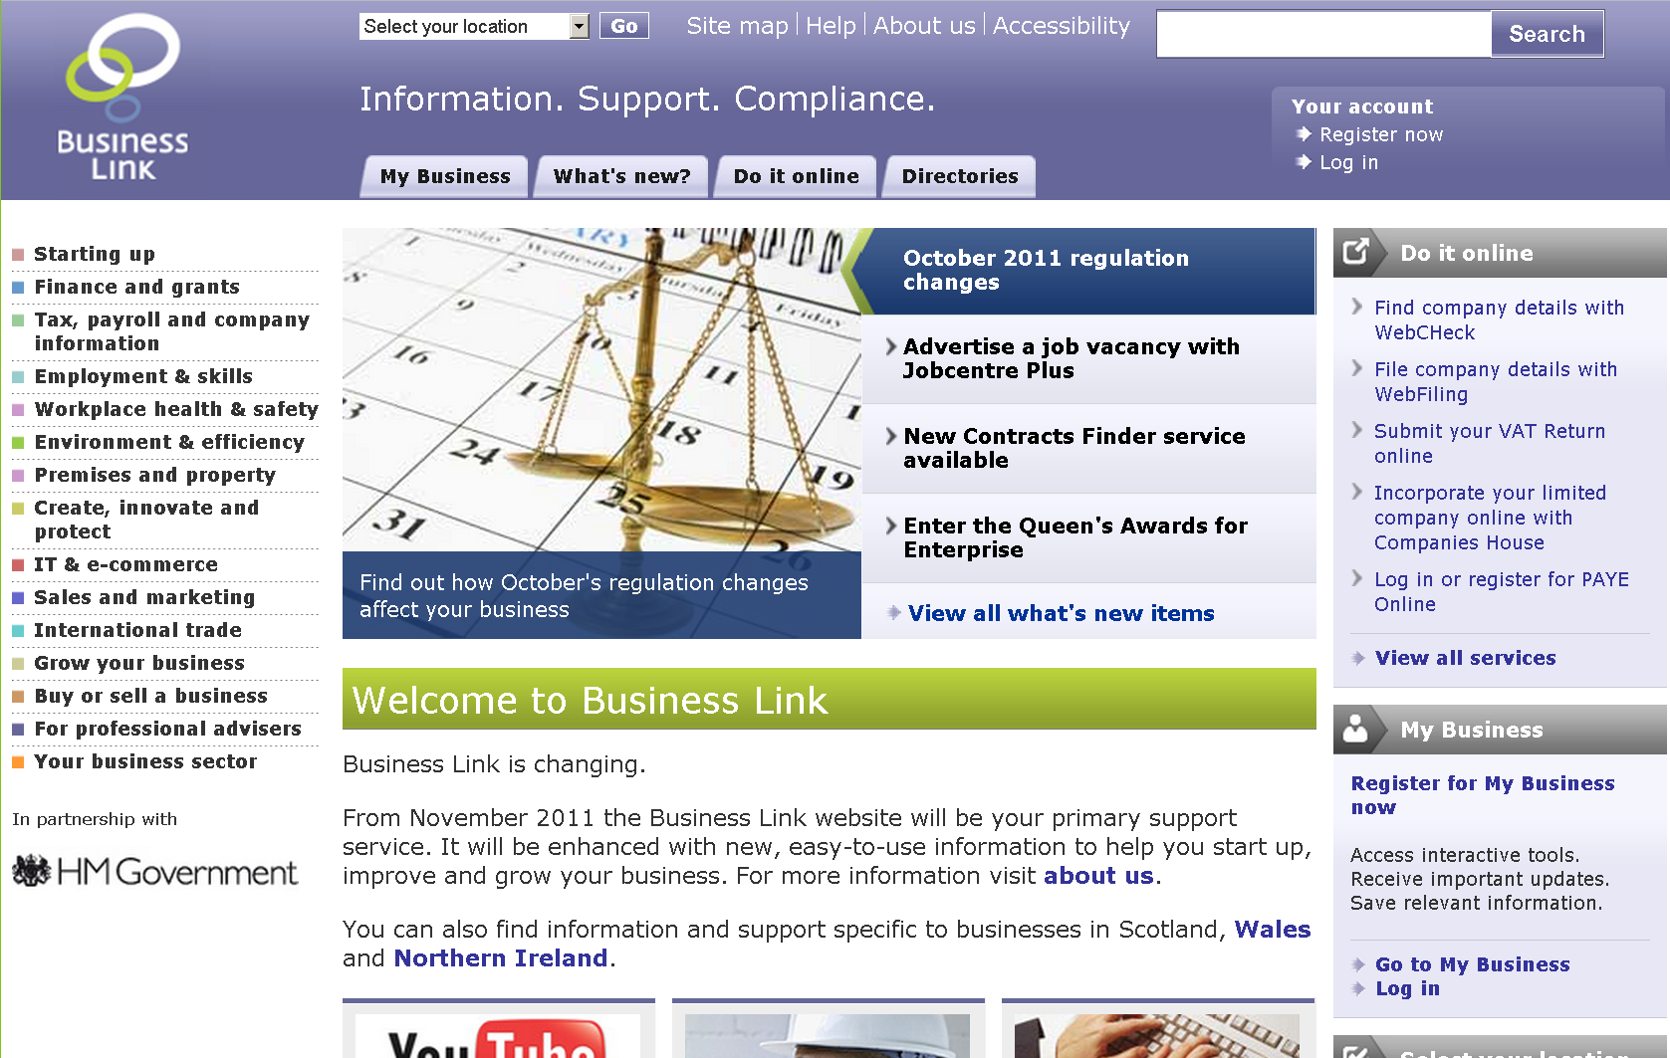

Slide 46
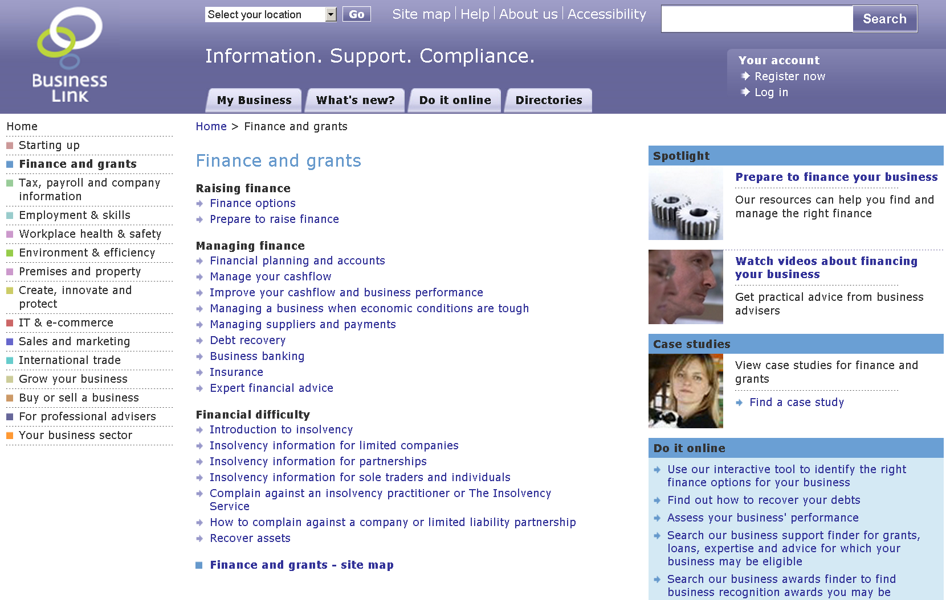

Slide 47
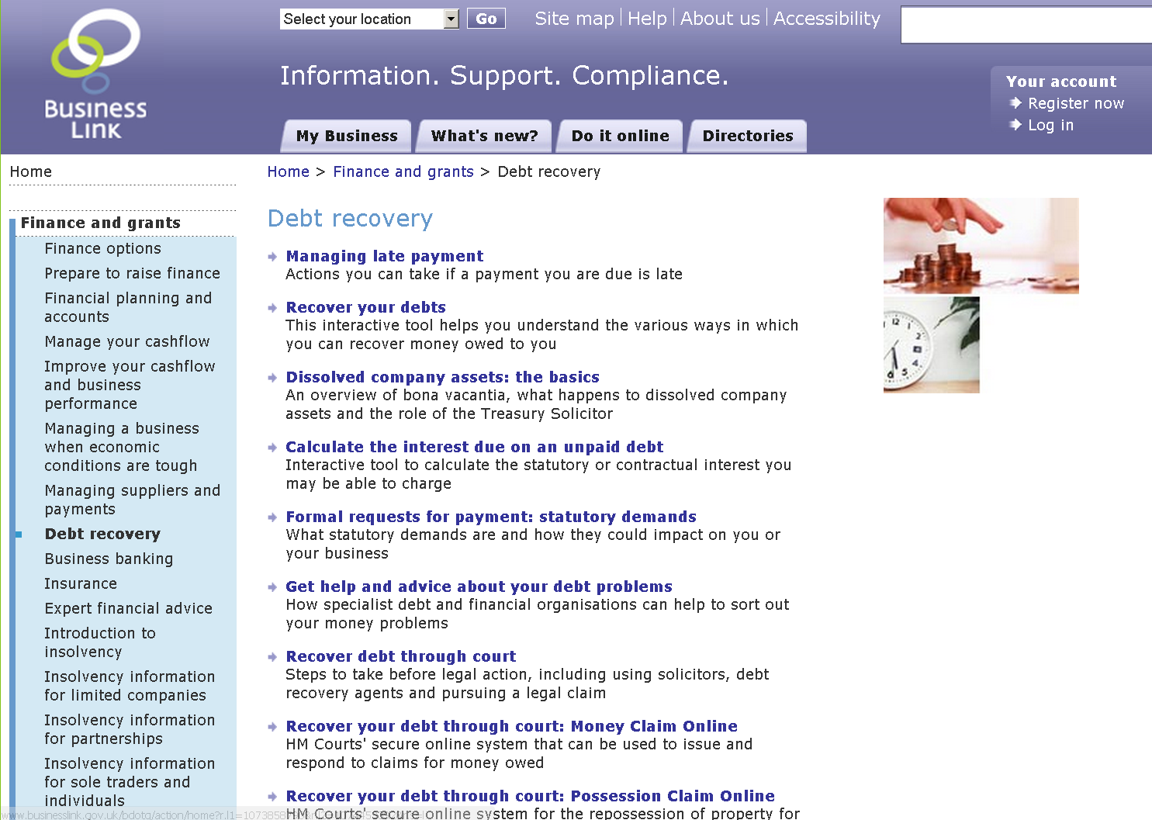

Slide 49
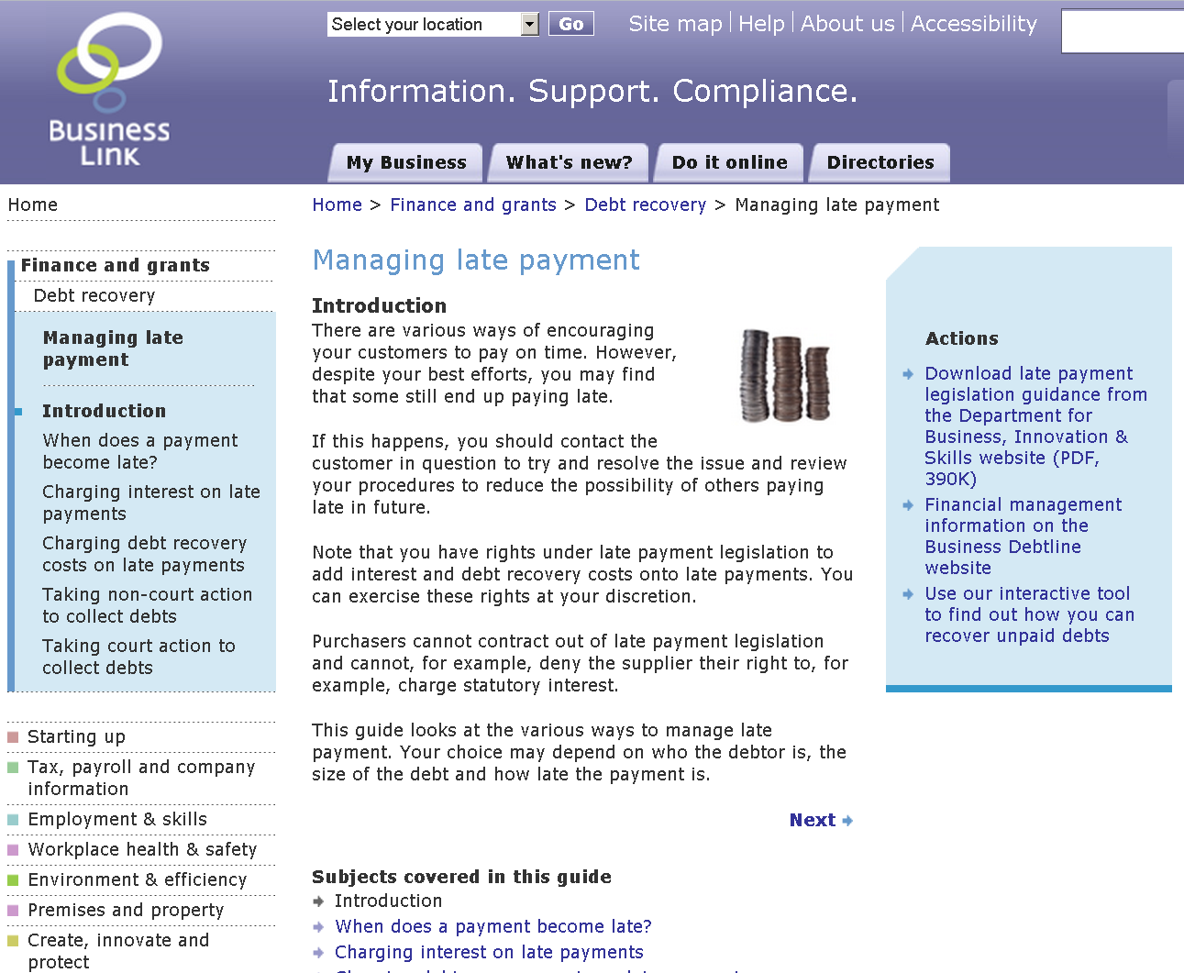

Slide 50
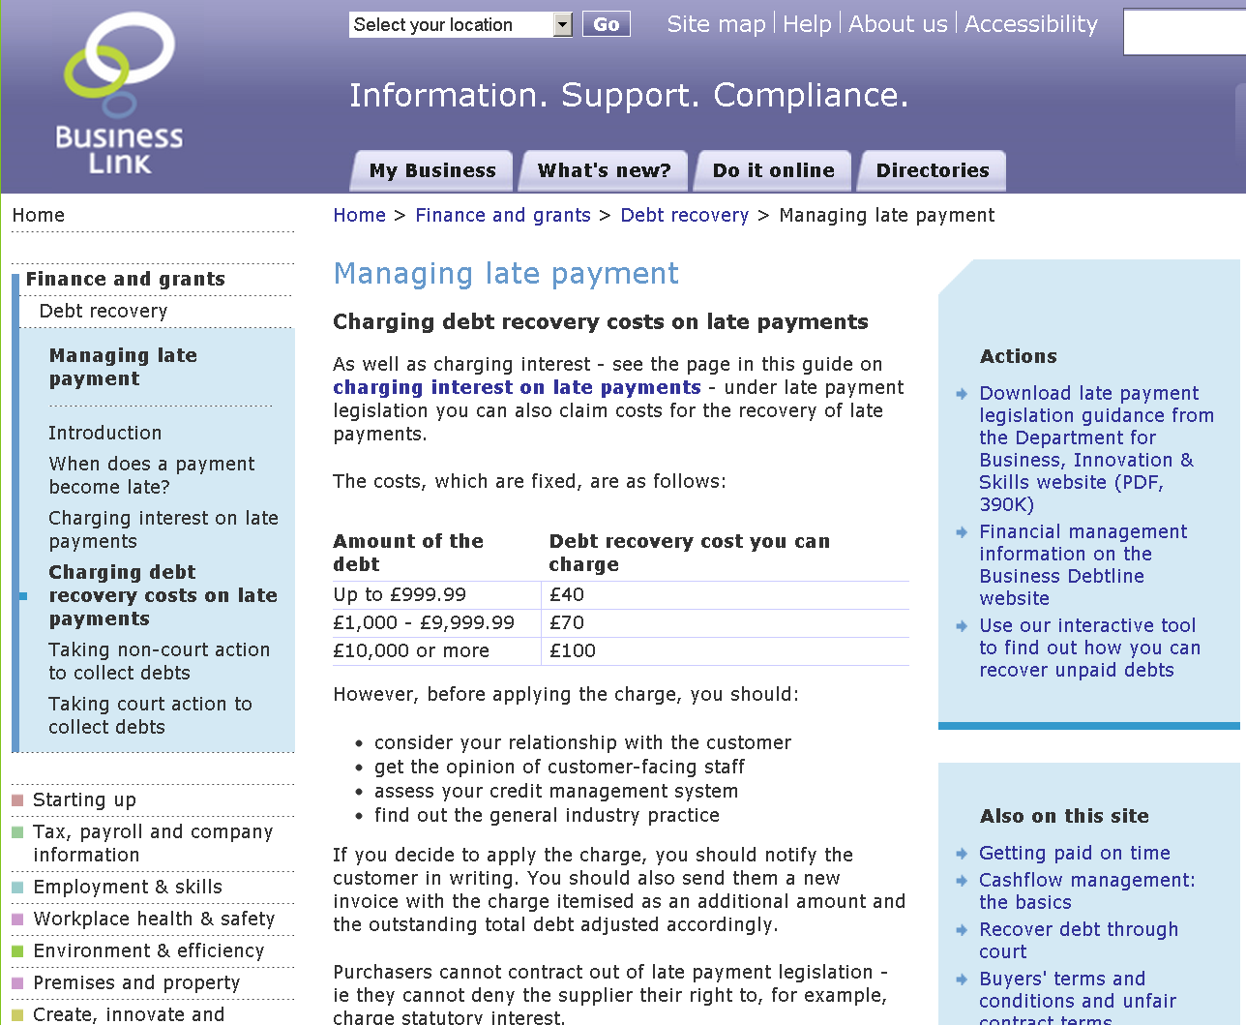

Slide 52
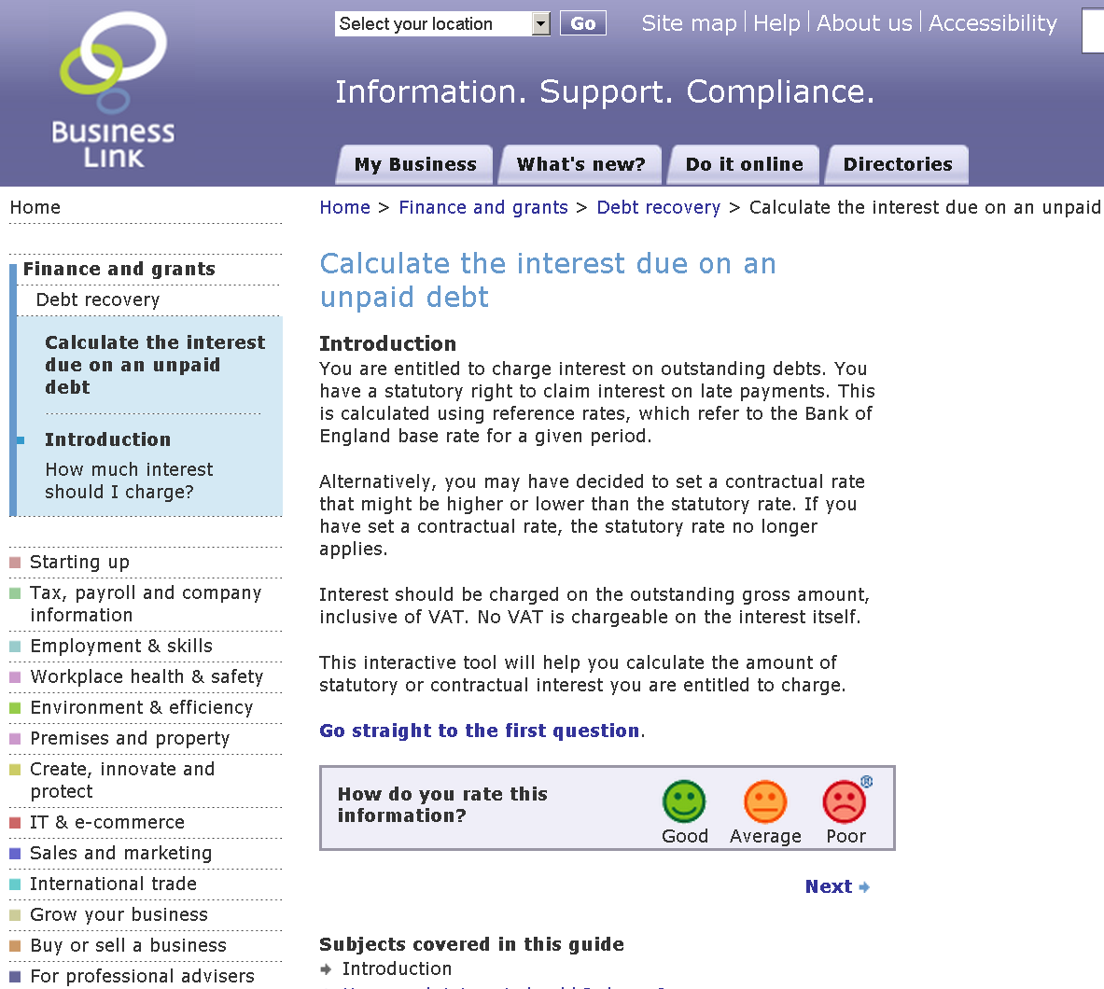

Slide 53
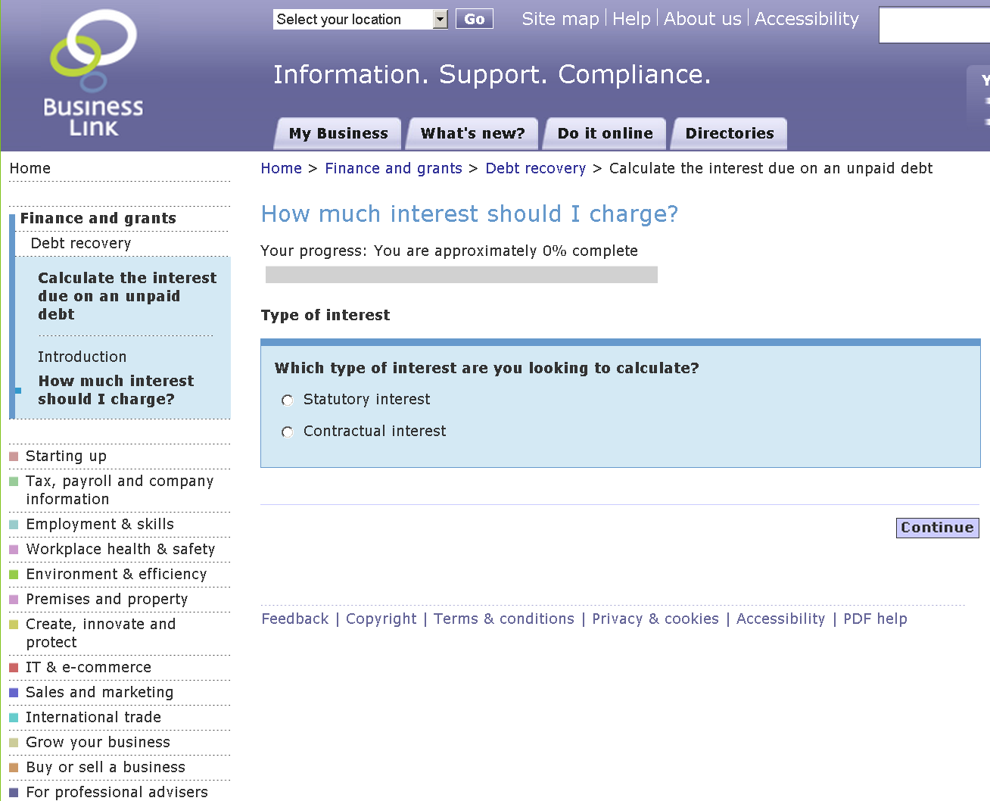

Slide 54
You have a debt owed to you of £2000. It became overdue on the 1st of June 2011. You have no contract with the debtor. You can charge interest. How much?

Slide 56
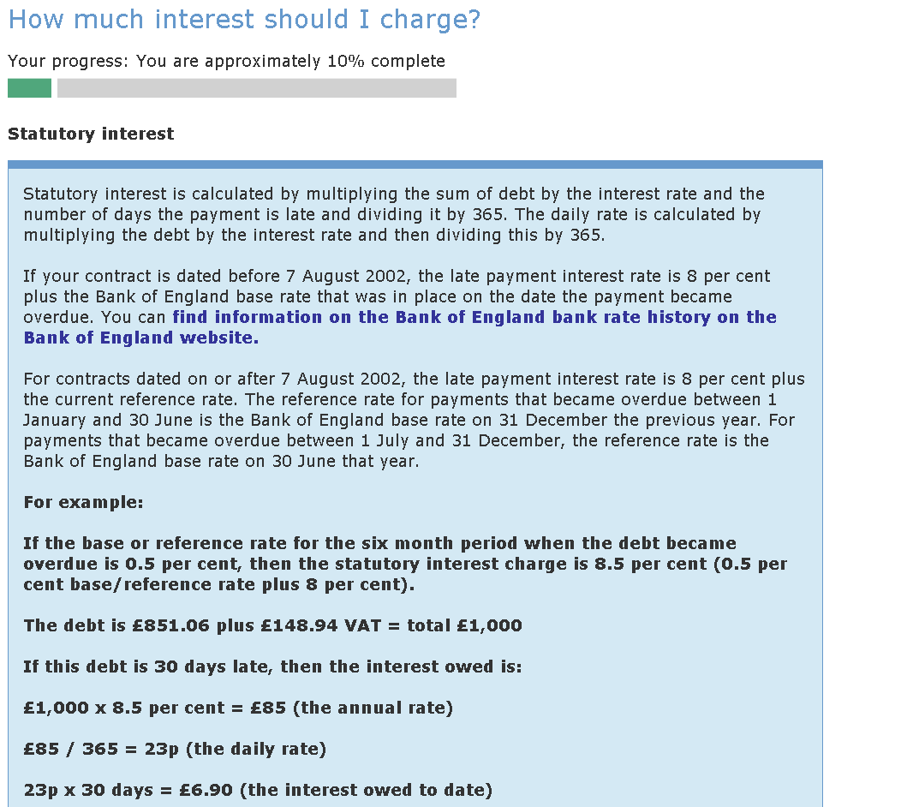
?

Slide 57
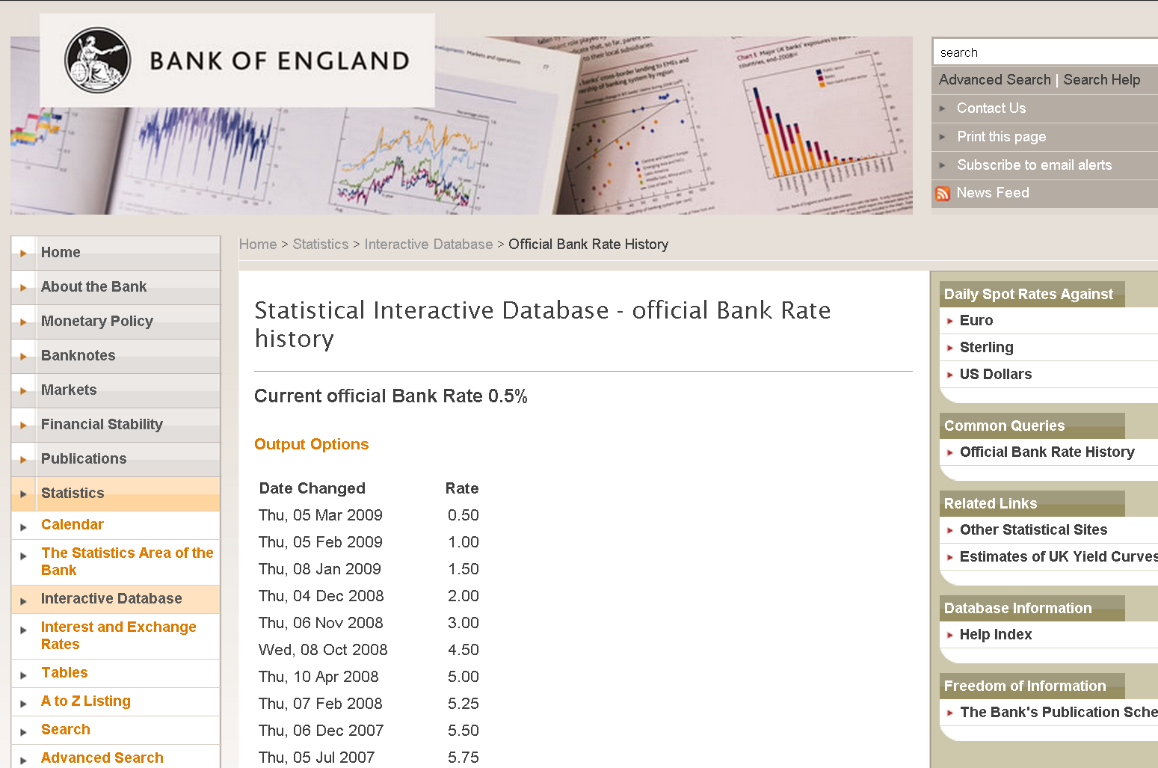

Slide 59
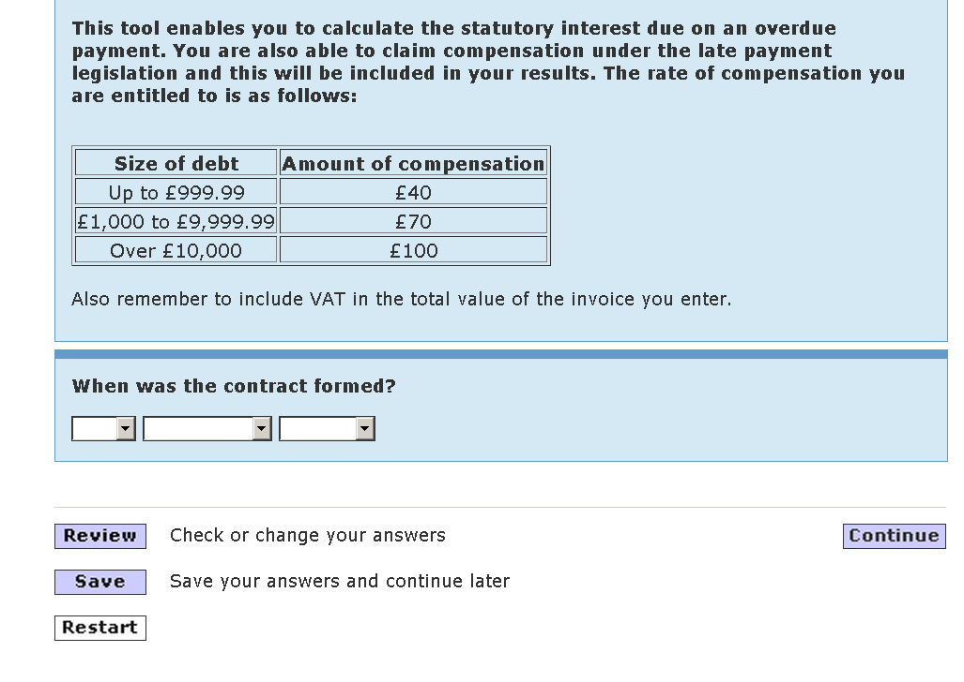

Slide 60
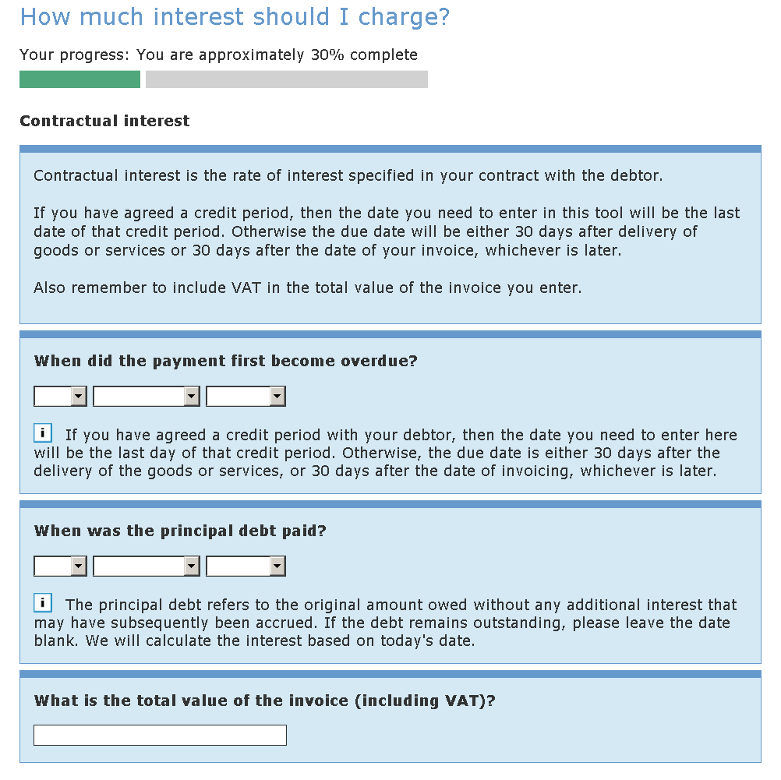

Slide 61
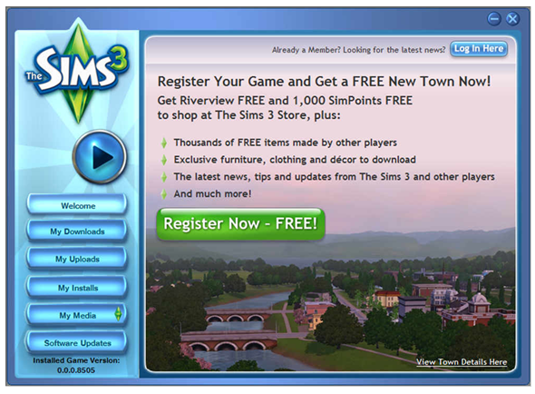

Slide 62


Slide 63
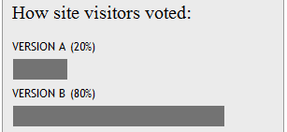
A
B
https://whichtestwon.com/

Slide 64
Thank you
WWW.
customercarewords.com
gerry@customercarewords.com
+353 87 238 6136
@gerrymcgovern

